Slide 1
Subject : E D B E
Chapter:Principles of Business Ethics
Semester:IV
Prof: Harsha Sethia(HS)
Dept. of Commerce
T.H.K.Jain College

Slide 2
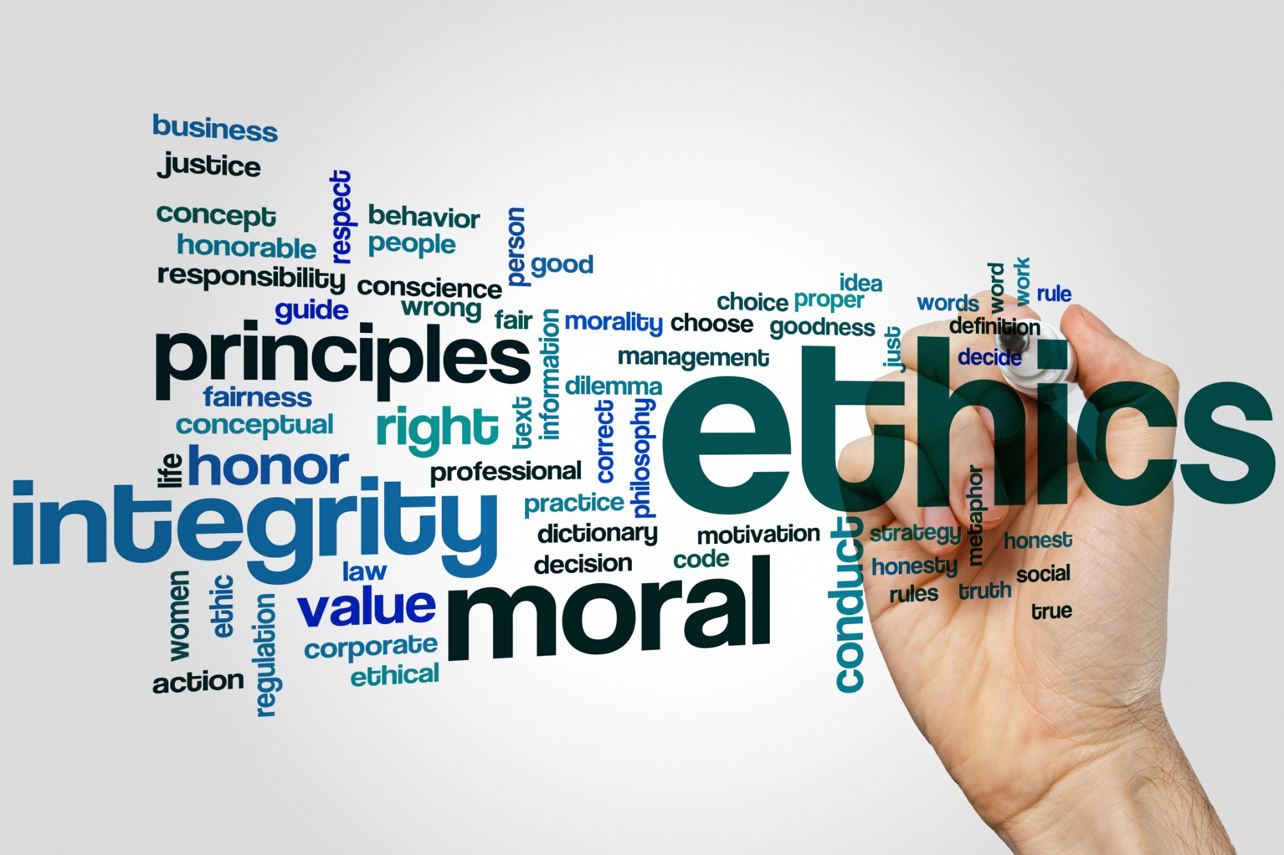

Slide 3
Concept of Ethical Principles
Ethical principles refers to the ethical values, which establish the desired levels of behavior that an individual / organization should or should not exhibit. In other words, ethical principles lay out the do’s and don’ts for them.
These principles provide guidance in resolving ethical issues .The important rules of business ethics are :
Fulfill expectations of the customers
Prevent consumer exploitation
Avoid profiteering
Promote healthy competition
Pay taxes on a regular basis

Slide 4
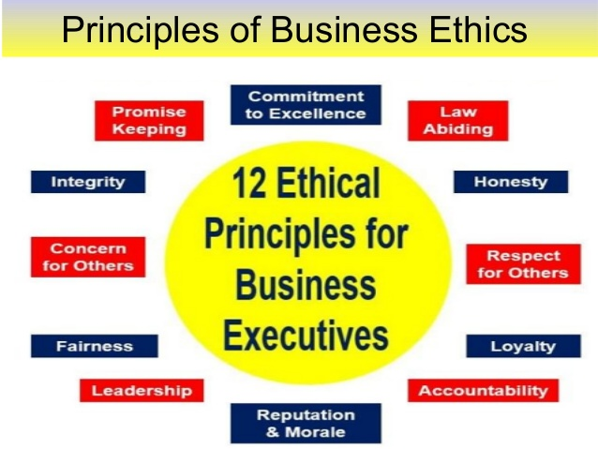

Slide 5
ELEMENTS OF PRINCIPLES OF BUSINESS ETHICS
ethics
morale
Business ethics
Ethical dilemma

Slide 7
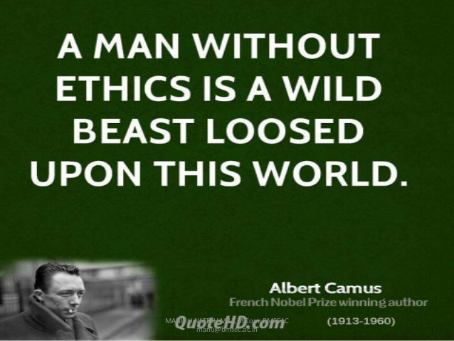

Slide 13
DIFFERENCE BETWEEN ETHICS & INTEGRITY
• Ethics can be defined as rules and regulations that have been formed which allow an individual to work in accordance to moral principles.
• Integrity can be defined as the quality of being honest and fair.
• Ethics are more external whereas integrity is internal.
• Ethics is not a choice whereas integrity is a personal choice.
• Ethics can be imposed on individuals, but integrity cannot be imposed on.

Slide 14
ETHICS & LAW
Law is a systematic set of universally accepted rules and regulations created by an appropriate authority such as government which may be local, regional or international. It is used to govern actions of individuals or members by imposing penalties for non-compliance.
ETHICS | LAWS
Ethics are rules of conduct. | Laws are rules developed by govt in order to protect its citizens.
Ethics does not carry any punishment to anyone who violates it. | The law will punish anyone who happens to violate it.
Ethics comes from within a person’s moral values. | Laws are made with ethics as a guiding principle.

Slide 17
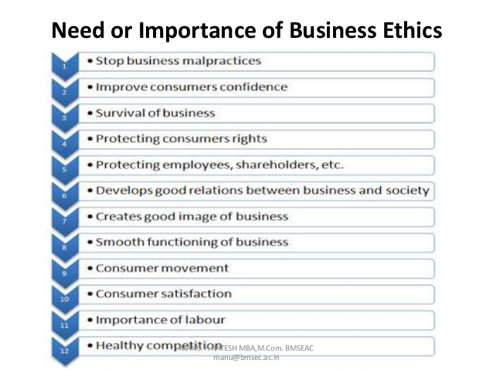

Slide 19
FEATURES OF ETHICAL DILEMMA
Right Choice
2. Sudden Occurrence
3. No linkage between two alternatives
4. Result is unique outcome
5. Uncertain Pressure

