Slide 1
HUMAN RESOURCE MANAGEMENT
UNIT 5: Job Evaluation
By Prof. CHAITALI GHOSH
THK JAIN COLLEGE
Class- B.Com (Hons)
Semester 2, Sec-2E

Slide 2
JOB EVALUATION
Definition
Job evaluation is a systematic process of evaluation and determining the value or worth of jobs performed. It helps to identify the worth or contribution of an employee’s efforts within the organisation.
Job evaluation is done for the purpose of establishing wage and salary credentials. The scope extends to develop an equitable wage and salary structure.
According to International Labour Organisation (ILO), ‘Job evaluation may be defined as an attempt to determine and compare the demands which the normal performance of particular jobs makes on normal workers without taking into account the individual abilities or performance of the works concerned.’

Slide 3
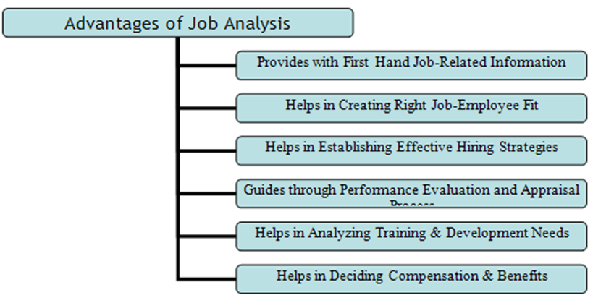

Slide 4
Features of Job Evaluation
Determining and comparing the demand of jobs
Not taking into account the individual abilities or performance
Determining a job’s relative worth
Formal and systematic comparison of jobs
Analysing and assessing the content of jobs
Creating a fair and logical remuneration system
Knowing the skills and other human qualities required to perform the job
Obtaining data that is useful in the design or redesign of the jobs

Slide 5
Objectives of Job Evaluation
Identifying range of competencies required to perform job related duties
Establishing a basis of an equitable salary structure within that organisation
Finding the basis of a fair and logical remuneration system
Installing system for consistent wage and salary structure
Ensuring five basics- quality, speed, dependability, flexibility, and cost.
Factors:-
Specific training need or qualification requirements to perform the assigned tasks better
Decision-making authority to develop leadership skills
Problem-solving skills and independent judgement for promptness

Slide 8
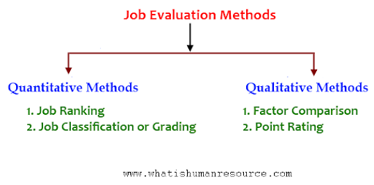

Slide 9
Job Evaluation Methods
Job Ranking Method:
It is the simplest method. Jobs are often arranged according to the relative difficulty in performing them. The job evaluation is using judgement. The evaluator just rank orders the jobs on the basis of his/her perception. This method can be easily adopted in small organizations.
Job Classification Method:
The general purpose of a job classification method is to create and maintain pay grades for comparable work across the organisation. This method uses job classes for more customized evaluation.
This method also uses scales to measure performance rather than simply comparing and ranking employee performances.

Slide 10
Contd..
Factor Comparison Method:
This method is more scientific and complex than the qualitative methods of ranking and classification. This methods assumes that there are 5 universal factors consisting of mental requirement, skills, physical requirement, responsibility, and working condition.
Point Method:
A rather using this method first identifies specific job factors such as knowledge and skills required to perform the job. Thereafter, he/she assigns numerical values to each factor.
The point method measures performance through scales and job factors rather than focusing on the entire job functions and ranking employees against each other.

