Slide 1
MARKETING MANAGEMENT
UNIT 2: CONSUMER BEHAVIOUR AND MARKET SEGMENTATION
PROF. SRIJITA DUTTA
THK JAIN COLLEGE
CLASS-B.COM (HONS and GEN) SEMESTER- II SEC- A and D

Slide 2
PART 1 CONSUMER BEHAVIOUR

Slide 3
CONSUMER BEHAVIOUR
The aim of marketing is to meet and satisfy target customers’ needs and wants. The field of consumer behaviour studies how individuals, groups and organisations select, buy, use, and dispose of goods, services, ideas, or experiences to satisfy their needs and desires.

Slide 4
Definition of Consumer Behaviour
According to Louden and Bitta, ‘consumer behaviour is the decision process and physical activity, which individuals engage in when evaluating, acquiring, using or disposing of goods and services’.
According to Walter and Paul, ‘consumer behaviour is the process whereby individuals decide what, when, where, how, and from whom to purchase goods and services’.
According to Engel, Blackwell, and Mansard, ‘consumer behaviour is the actions and decision processes of people who purchase goods and services for personal consumption’.

Slide 5
NATURE OF CONSUMER BEHAVIOUR
A Process
Mental and Physical Activities
Influenced by various factors
Undergoes a constant change
Varies from consumer to consumer
Information on consumer behaviour is important to the marketers
Leads to purchase decision
Improves standard of living
Reflects status

Slide 7
INFLUENCES OF CONSUMER BEHAVIOUR
INTERNAL FACTORS
EXTERNAL FACTORS
PERSONAL
PSYCHOLOGICAL
AGE
INCOME
OCCUPATION
LIFESTYLE
PERSONALITY
MOTIVATION
PERCEPTION
LEARNING
BELIEFS AND ATTITUDE
CULTURAL
SOCIAL
CULTURE
SUB-CULTURE
SOCIAL CLASS
FAMILY
REFERENCE GROUP
ROLE AND STATUS

Slide 8
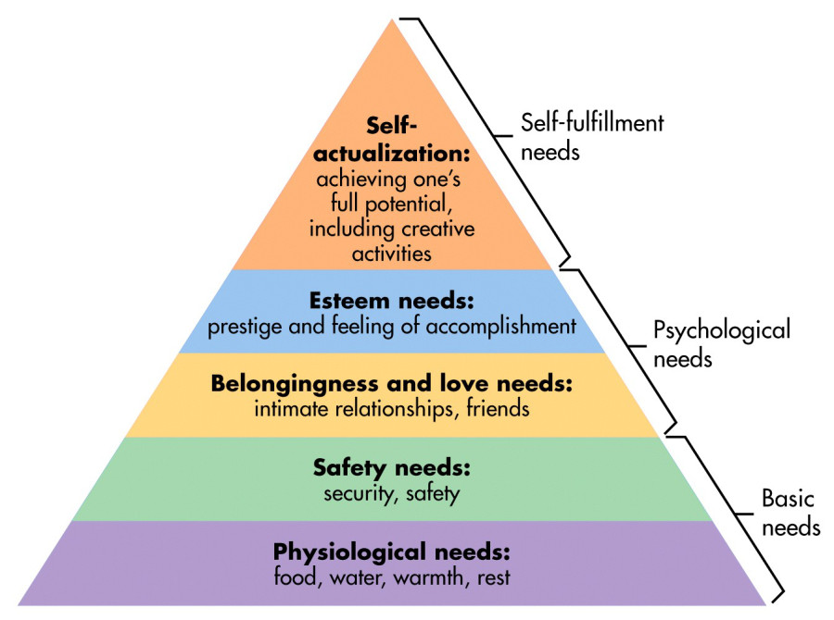
MASLOW’S HIERARCHY OF NEEDS

Slide 9
THANK YOU

