Slide 1
Lycophyta- General Characters

Slide 2
Lycophyta- Club Moss or Spike Moss
Plants of this class are known as club moss or spike moss
The plant body of club mosses is differentiated into root, stems and root.
Sporangia are formed on sporophylls.
These sporophylls are not scattered on stem institute their present instead they are present in groups at tip of plant.

Slide 3
Habitat- Club Moss

Slide 4
Habitat- Spike Moss

Slide 5
Lycophyta- general characters
This class has a long evolutionary history and is represented both by extant and extinct genera.
This group first originated during the Lower Devonian period of Palaeozoic Era.
The Lycophytes are the oldest of the seedless vascular plants that have living representatives.
Their structural features show convergence with taxa on the line leading to the flowering plants. Leaves, wood, trees, and reproductive structures that resemble seeds evolved in both lineages.
There are about 1,200 species today in three lycophyte families: Lycopodiaceae, Selaginellaceae, and Isoetaceae.
This class is represented by five living genera :
— Lycopodium, Selaginella, Phylloglossum, Styhtes, and Isoete
and fourteen extinct genera
— Asteroxylon, Baragwanathia, Lepidodendron, Sigillaria etc.

Slide 6
General charactres
The sporophyte plant body is differen­tiated into definite root, stem and leaves.
(b) The sporophytes are dichotomously branched.
(c) The leaves are usually small and microphyllous.
(d) The xylem in stem exarch.
(e) Sporangia are borne singly on the adaxial (upper) surface of the sporophylls.
(f) The spores may be of either one type i.e., homosporous (e.g., Lycopodium) or two types i.e., heterosporous (e.g., Selaginella).
(g) The spores develop into independent gametophyte.

Slide 7
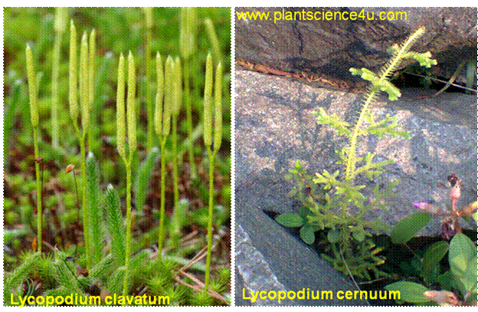
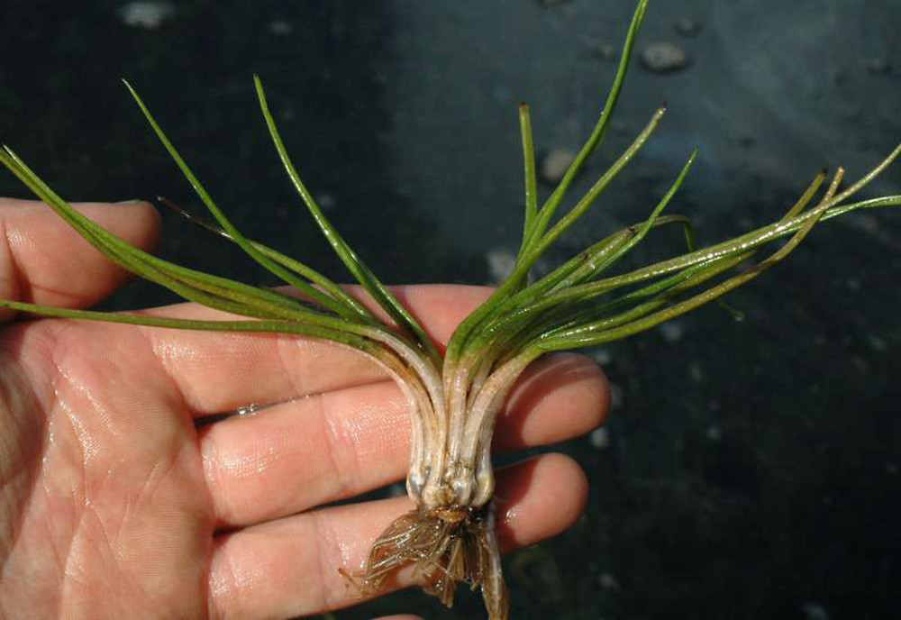
Lycophyta- Representative genera
Isoetes

Slide 8
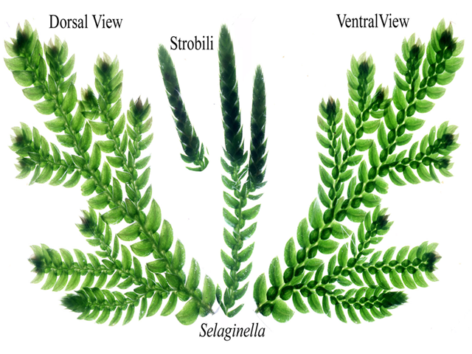
Lycophyta- Representative genera

Slide 9
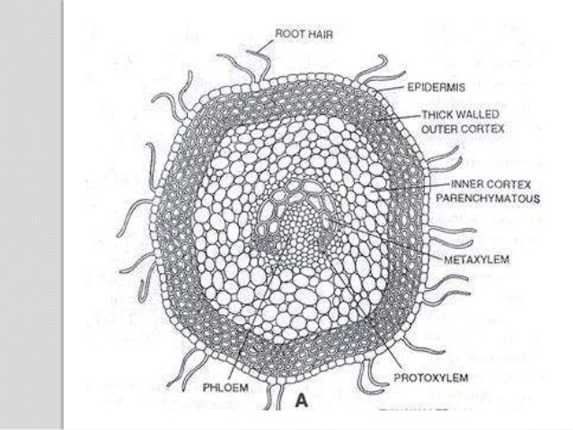
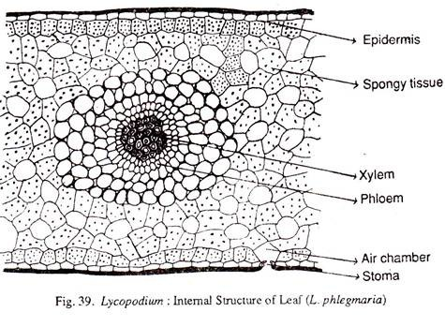
Lycophyta- internal structure

Slide 10
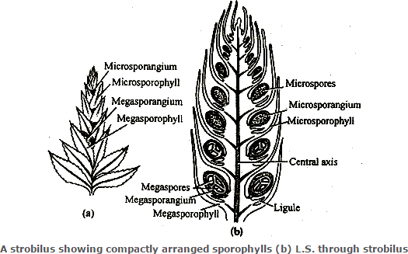
Lycophyta- Structure of strobilus

Slide 11
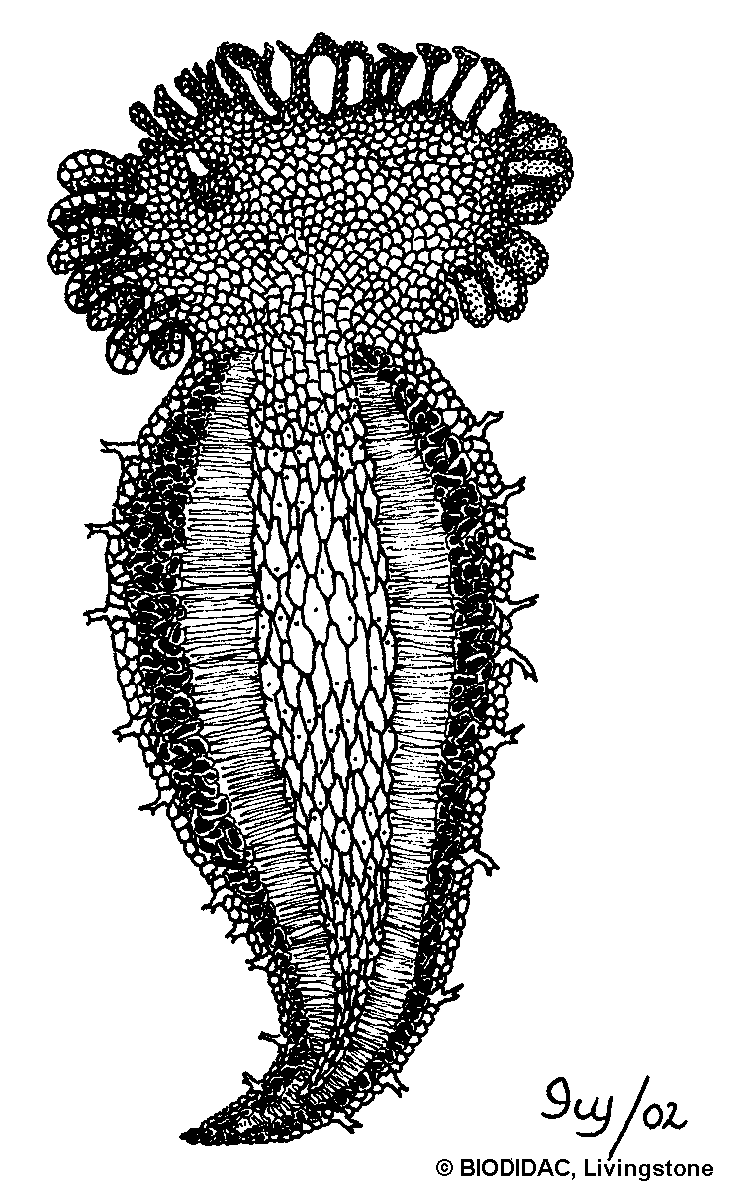
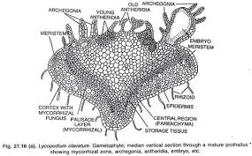
Lycophyta- Gametophyte

Slide 12
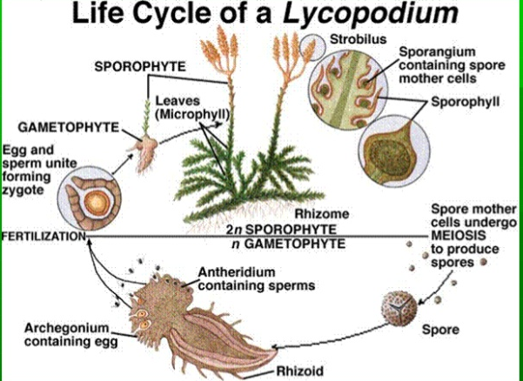
Life cycle of homosporous genera

Slide 13
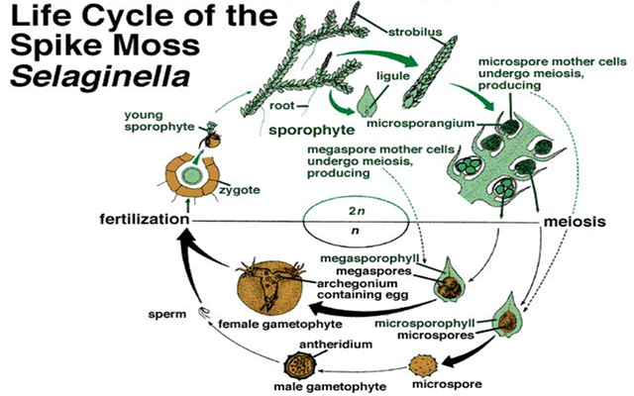
Life cycle of heterosporous genera

