Slide 1
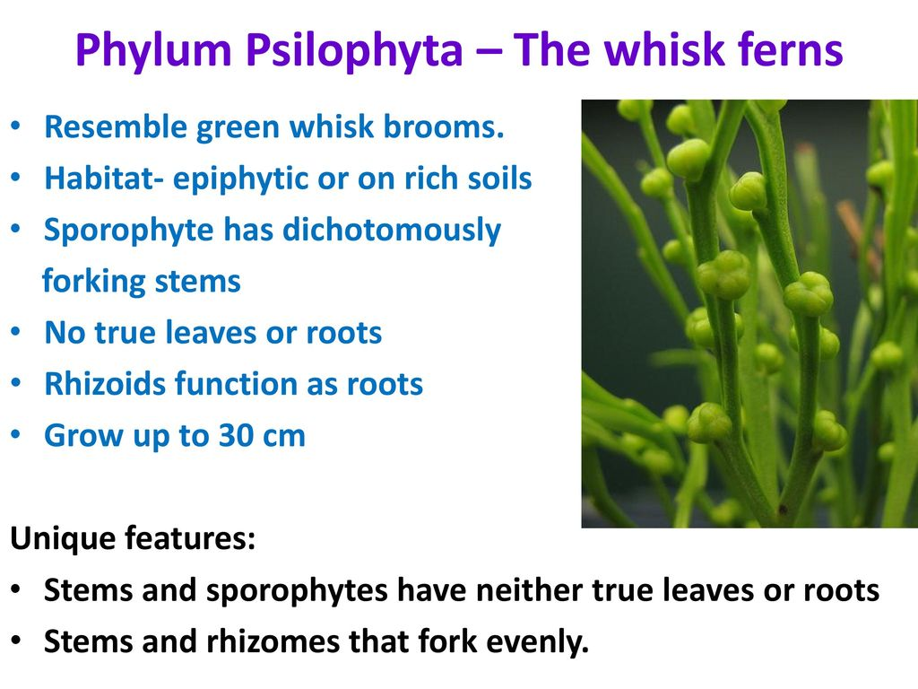
Psilophyta

Slide 2
General Characters
The Class is represented by two living genera – Psilotum and Tmeseptris .
The general characters are as follows:
1. The plant body is a rootless sporophyte that differentiates into a subterranean rhizome and an aerial erect shoot.
2. Branching is dichotomous in both sub­terranean rhizome and aerial shoot.
3. The large rhizoids borne on the rhizome absorb water and nutrients from the soil.
4. On the aerial shoots, spirally arranged scale-like (e.g., Psilotum) or leaf-like appendages (e.g., Tmesipteris) are borne.

Slide 3
General Characters
5. Stele is protostelic or siphonostelic with sclerenchymatous pith.
6. Secondary growth is absent.
7. Bi- or trilocular sporangia are borne in the axils of leaf-like appendages.
8. Mode of sporangial development is of eusporangiate type.
9. Spores are of equal sizes and shapes i.e., homosporous.
10. The gametophytes are non-green, cylindri­cal, branched and subterranean. They grow as saprophytes with an associated endophytic fungus.
11. Antherozoids are spirally coiled and multi- flagellated.

Slide 4
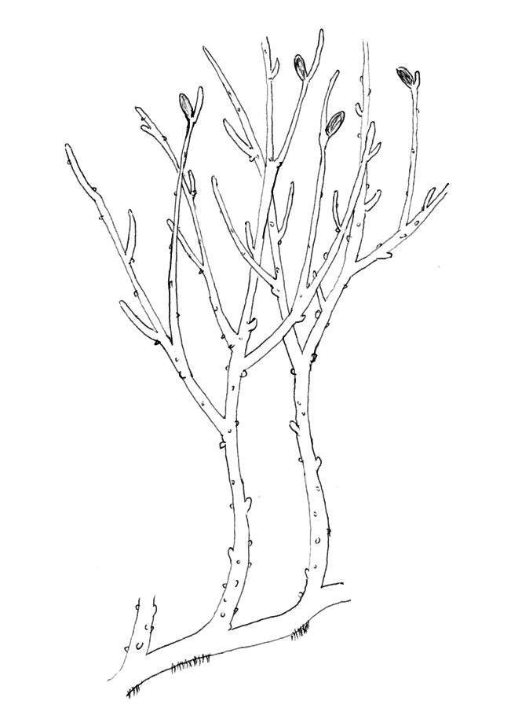
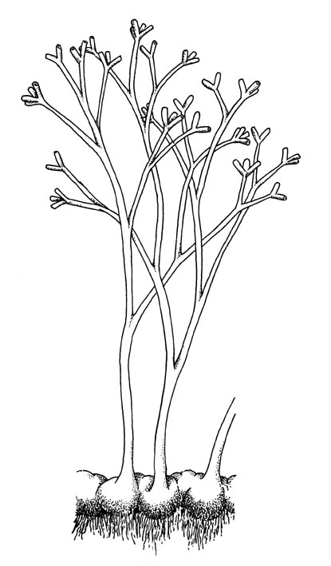
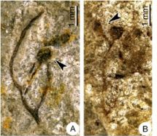
Psilophyta (Fossils)
Rhynia sp
Rhynia sp
Horneophyton sp

Slide 5
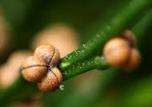
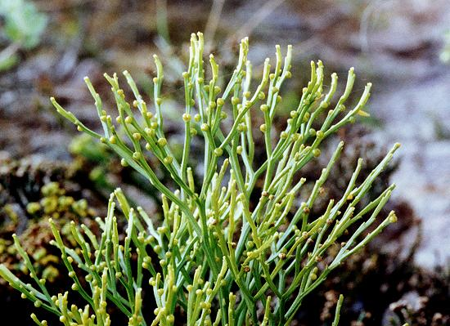
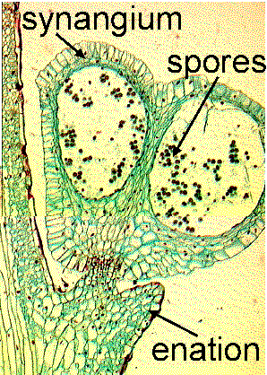
Psilophyta-Psilotum

Slide 6
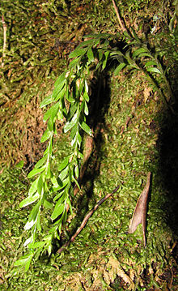
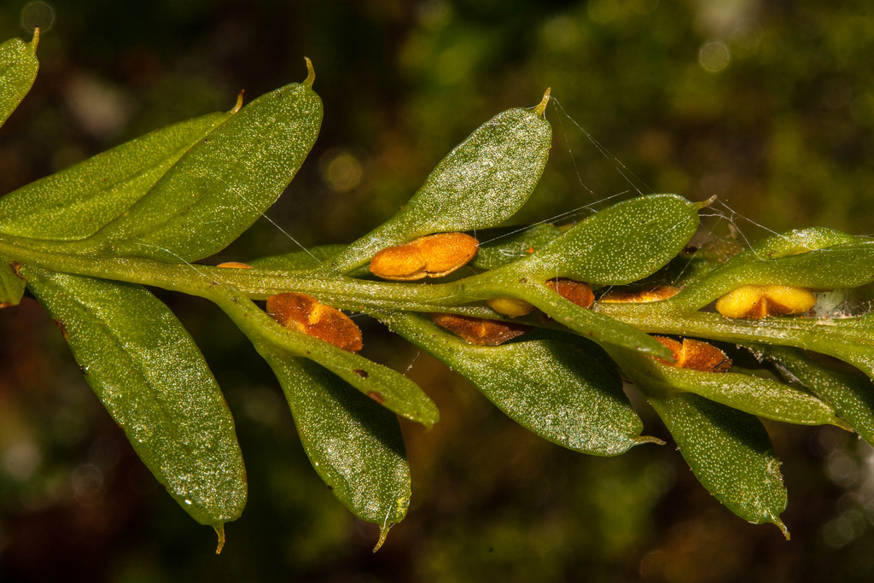
Psilophyta- Tmesipteris

Slide 7
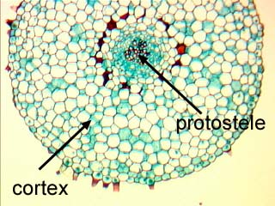
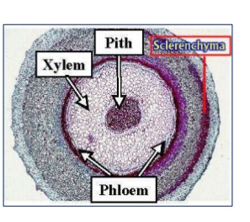
Psilophyta- Anatomy of stem
Protostele
Siphonostele

Slide 8
Psilotum
The sporophyte of Psilotum looks like a survivor from the Devonian age.
it has no leaves nor roots, a protoxylem, a dichotomously branching green stem with small scales.
The stem bears bright yellow synangia (formed from three fused sporangia) on short lateral branches.
It is homosporous and the spores develop into bisexual gametophytes that resemble pieces of sporophyte rhizome.
The data from current RNA sequencing and other chemical analyses suggests that Psilotum appears to be a descendent of the ferns by loss and simplification of structures.

Slide 9
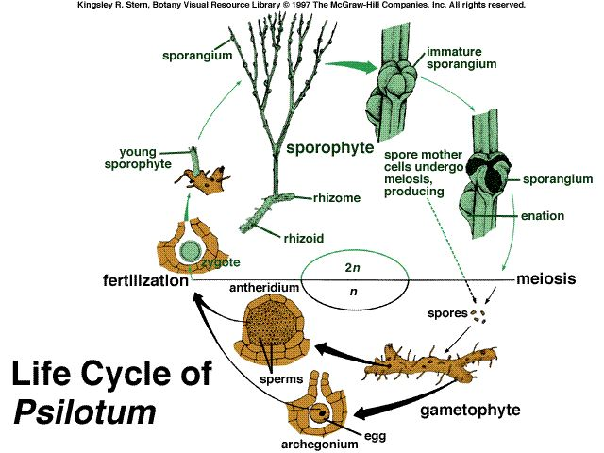
Life cycle of Psilotum

