Slide 1
STANDARD COSTING
By
Chaitali Pal

Slide 4
Definition of standard cost according to the CIMA London, “predetermined cost which is calculated from management’s standards of efficient operations and relevant necessary expenditure.” They are the predetermined costs on technical estimate of material labor and overhead for a selected period of time and for prescribed set of working conditions.

Slide 16
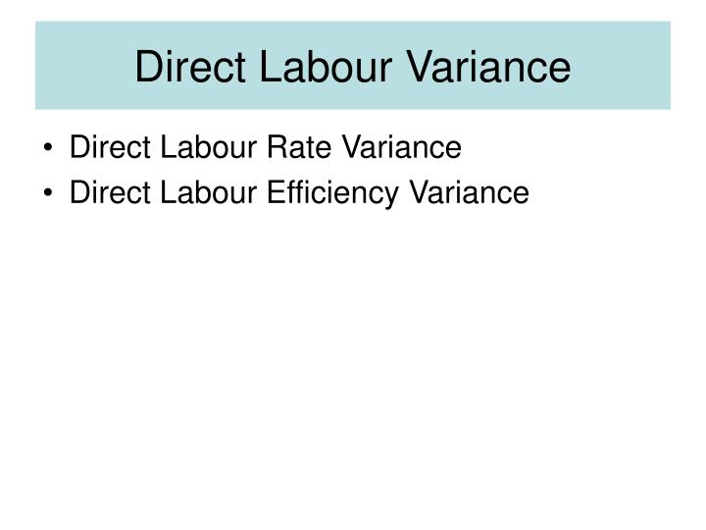

Slide 24
ADVANCE VARIENCE ANALYSIS

