Slide 1
MARKETING MANAGEMENT
UNIT 2: CONSUMER BEHAVIOUR AND MARKET SEGMENTATION
PROF. SRIJITA DUTTA
THK JAIN COLLEGE
CLASS- B.COM (HONS and GEN) SEMESTER- II SEC- A and D

Slide 2
PART 2 MARKET SEGMENTATION

Slide 3
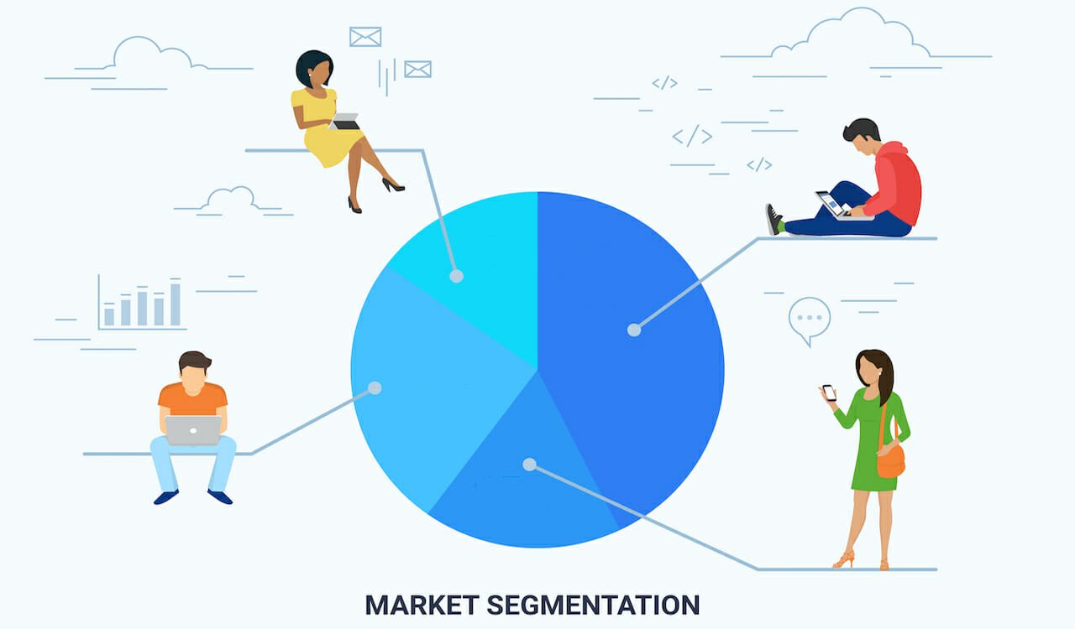
Target Marketing
A company cannot serve all customers in a broad market. The customers are too numerous and diverse in their buying requirements. Many companies are embracing Target Marketing. Here, sellers distinguish the major market segments and develop products and marketing programs tailored to each. Target Marketing requires marketers to take three major steps:
Market Segmentation
Market Targeting
Market Positioning

Slide 4
Market Segmentation
Segmentation is all about dividing the market, by grouping together customers with similar tastes and preferences in to one segment, to serve it better.
Market segmentation is the process of dividing a broad heterogeneous market consisting of existing and potential customers into a number of homogeneous sub-groups on the basis of shared characteristics of customers that is, in respect of similarities of their needs, wants, likes, dislikes, attitudes, tastes, preferences, buying pattern, buying abilities, etc.

Slide 5
Importance of Market Segmentation
Maximizing customer satisfaction
Effective marketing strategies
Maximum customer satisfaction and good customer relation
Essence of modern marketing
Providing better service
Capturing opportunities in the market
Optimum utilization of resources
Benefit of specialization
Facing competition
Increase in profitability
Benefit to small-scale industries

Slide 6
Bases of Market Segmentation
Bases of Market Segmentation
On the basis of consumer characteristics
On the basis of consumer responses
Geographic
Demographic
Psychographic
Nation
Regions
States
Cities
Age
Family size
Life cycle
Gender
Income, Occupation
Education
Race
Nationality
Lifestyle
Personality
Values
Behavioural
Occasions
Benefits
User Status
Usage Rate
Loyalty Status
Attitude
Buyer Readiness Stage

Slide 7
Distinction between Product Differentiation and Market Segmentation
PRODUCT DIFFERENTIATION | MARKET SEGMENTATION
1) Product Differentiation relates to making a product different in terms of product-related qualities, from those offered by competitors. | Market segmentation involves breaking down the potential market for a product or service into homogeneous group of customers.
2) Product differentiation focuses on imparting a distinctive identity to a product. | 2) Market segmentation focuses on dividing a large market into small homogeneous sub-markets, on the basis of which marketing efforts may be directed.
3) Product differentiation equips an organization to remove price competition faced by a product from its competitors by imparting a distinct identity to the product. | 3) Market segmentation equips an organization to expand its target market and orient its marketing efforts on the basis on the attributes of the market segment for which a product is directed.
4) Product differentiation emphasises on branding. | 4) Market segmentation emphasises on customers, both existing and potential.

Slide 8
Market Targeting
In Market targeting, marketers must focus their attention on targeting the market segments that are relevant to their products and likely to respond positively to their marketing strategies.
Selecting the Market Segments
1) Single Segment Concentration: The strategy of targeting a single segment has worked well for some marketers, like Mercedes only concentrates on the upper income group customers.
2) Selective Specialization: Automobile manufacturer Hyundai manufactures different models of cars like the Santro, Accent, Verna etc. To cater to different segments with different level of income.
3) Product Specialisation: Some companies specialise in a particular product, like Gillette is famous worldwide for its series of shaving products.
4) Market Specialisation: Companies like the Ordinance Factories caters to the needs of the Indian defence services by manufacturing different types of arms and ammunitions for them.
5) Full Market Coverage: Only very large firms can undertake a full market coverage strategy. Examples include IBM (computer market), General Motors (vehicle market), and Coca-Cola (drink market).

Slide 9
Market Positioning
Positioning is the act of communicating the company’s offer so that it occupies a distinct and valued place in the customers’ mind. After a company has divided the market into segments and targeted one or more segments, it now needs to establish and communicate the products’ key distinctive benefits to the target group(s) in the market.
According to Rooser Reeves, a company should develop an Unique Selling Proposition (USP) for each of its brand. An USP can be any special attributes about the brand like quality, price, service, value, safety provisions, technology etc. Marketers often try to promote the product on the basis of its USP. Number one positioning include ‘best quality’, ‘lowest price’, ‘best value’, ‘best service’, ‘safest’, ‘most advanced technology’ etc.

Slide 10
Thank You

