Slide 1
MARKETING MANAGEMENT-SEMESTER-II
UNIT-4 DISTRIBUTION CHANNELS AND PHYSICAL DISTRIBUTION
------- BY PROF. JAYASREE DAS
(syllabus-channel of distribution-meaning and importance; types of distribution channels, factors effecting choice of distribution channel)

Slide 2
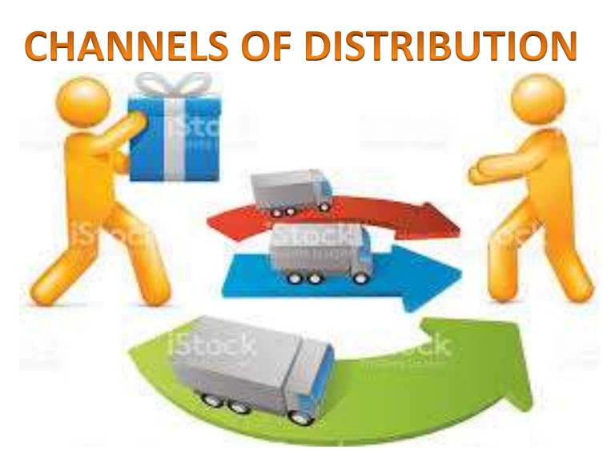
Definition: Channel Distribution
Distribution channel is a distribution network through which products move from producer or manufacturers to ultimate consumers or users. The channel comprises of producers, consumers or users and the other middlemen like wholesalers, selling agents and retailers(dealers) who mediate between the manufacturers and consumers.

Slide 3
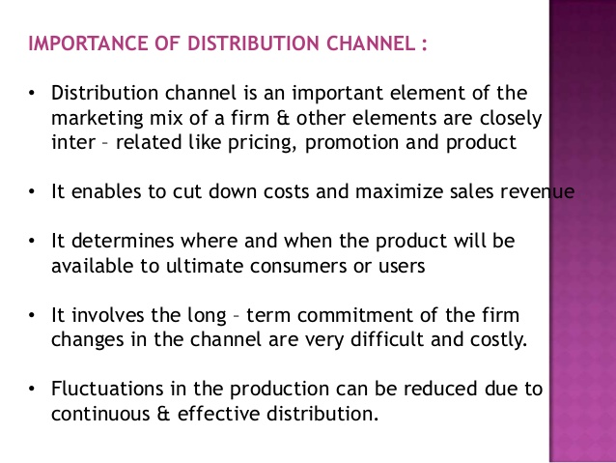

Slide 4
Components of distribution system:
The distribution system involves two components such as below.
Channels of distribution
Physical distribution
Channels of distribution: – means a process through which the products are transferred from the producers to the ultimate consumers. It also known as marketing channels. The channels members such as merchants agents wholesalers and retailers are middlemen in distribution and they perform all marketing functions. These channels members such as merchants agents wholesalers and retailers are middlemen in contribution and try perform according to marketing functions. These middlemen facilitate the process of exchange and create time, place and possession utilities through matching and sorting process. Sorting enables meeting or matching the supply with consumers demand.
Physical distribution: – it looks after physical handling of goods and assures maximum customers services. It aims at offering of delivery of right goods at the night distribution activities cover:
Order processing
Packaging
Warehousing
Transportation
Inventory control
Customer service.
All middle in distribution on performs these function and they assure putting the products with in an arm’s length customer’s desire and demand.

Slide 5
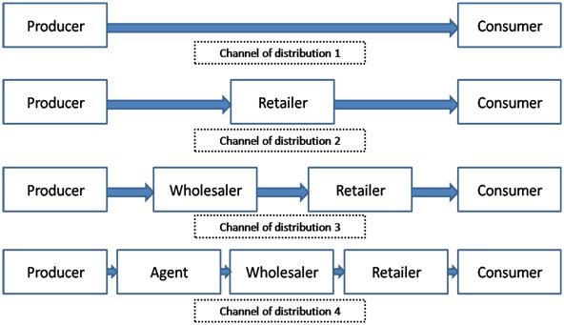
CHANNEL OF DISTRIBUTION

Slide 6
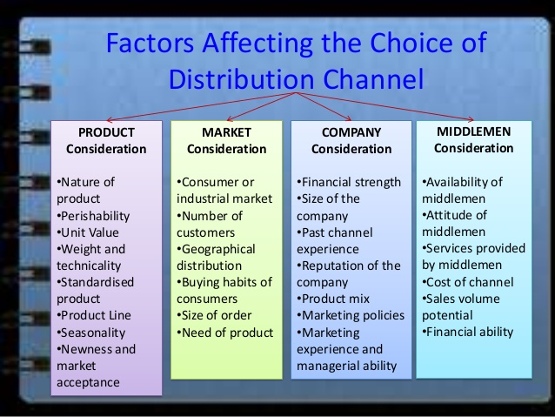

Slide 7
Functions of Distribution Channels :
In order to understand the importance of distribution channels, you need to understand that it doesn’t just bridge the gap between the producer of a product and its user.
Distribution channels provide time, place, and ownership utility. They make the product available when, where, and in which quantities the customer wants. But other than these transactional functions, marketing channels are also responsible to carry out the following functions:
Logistics and Physical Distribution: Marketing channels are responsible for assembly, storage, sorting, and transportation of goods from manufacturers to customers.
Facilitation: Channels of distribution even provide pre-sale and post-purchase services like financing, maintenance, information dissemination and channel coordination.

Slide 8
Functions of Distribution Channels- CONTD
Creating Efficiencies: This is done in two ways: bulk breaking and creating assortments. Wholesalers and retailers purchase large quantities of goods from manufacturers but break the bulk by selling few at a time to many other channels or customers. They also offer different types of products at a single place which is a huge benefit to customers as they don’t have to visit different retailers for different products.
Sharing Risks: Since most of the channels buy the products beforehand, they also share the risk with the manufacturers and do everything possible to sell it.
Marketing: Distribution channels are also called marketing channels because they are among the core touch points where many marketing strategies are executed. They are in direct contact with the end customers and help the manufacturers in propagating the brand message and product benefits and other benefits to the customers.

Slide 9
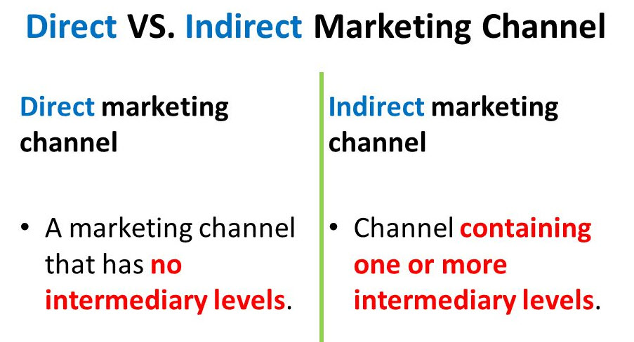

Slide 10
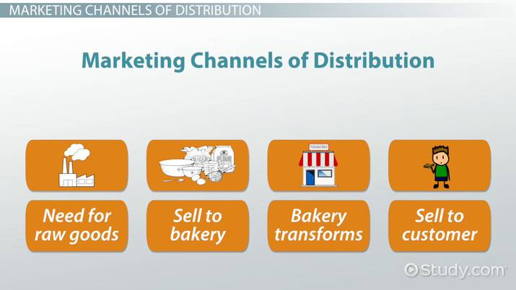
IN A NUTSHELL….CHANNEL OF DISTRIBUTION IS

