Slide 1
Semester- IV BUSINESS ETHICS Chapter-2 Principles Of business Ethics
Bandana Sinha
Commerce Faculty
THK Jain College

Slide 3
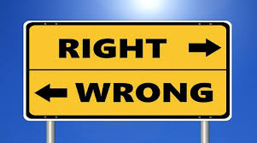
What is Ethics??
Ethics is a code of conduct,
which helps sentient beings comprehend the differences between
what they have the right to do and what is right for them to do.

Slide 5
What is Business Ethics??
Business ethics refers to the right and wrong behavior in business decision.
It is concerned with the critical and structured examination of the principles, values and standard that guide behavior in the sphere of the business.

Slide 6
What is Ethical Principle??
Ethical Principles refer to the ethical values, which establish the desire level of behavior that an individual/organization should or should not exhibit.
In short, ethical principles lay out the do’s and don’ts for the organization /individual.

Slide 7
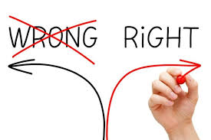
Elements of Principles of Business Ethics
Identification
Evaluation
Imagination
Tolerance
Obligation
Competence
Trustworthiness
Confidentiality
openness

Slide 8
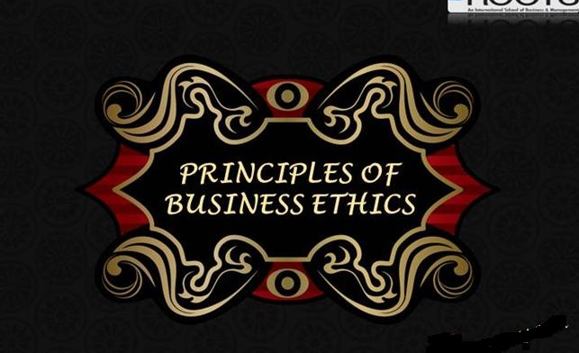
Principles of Ethics
Autonomy
Beneficence
Confidentiality
Do mo harm/Non- maleficence
Equity or Justice

Slide 9
Principles of Business Ethics
Integrity
Loyalty
Honesty
Respect and Concern
Fairness

Slide 10
Principles of Business Ethics for Business Executives
Principle of Conscience
Principle of Wish less Work
Principle of Esprit
Principle of Publicity
Principle of Purity
Principle of Humanity
Principle of Commitment
Principle of Rationality
Principle of Communicability
Cont………

Slide 11
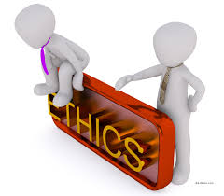
Cont……
Principle of non-Cooperation in Evils
Principle of Cooperation with Other
Principle of Satisfaction
Principle of Coordinate Ends and Means
Principle of Due Process
Principle of Liking in Expectations
Principle of Transparency

Slide 12
Ethical “Isms”
Subjectivism: It state morality is the matter of sentiment rather than fact.
Emotivism: It is a moral statement of that does not provide information about the speaker’s feeling but about the topic but it expresses the feeling.
Prescriptivism: Prescriptivists think ethical statements are instructions or recommendations.
Intuitionism: Intuitionist thinks that goodness and badness can only be detected by adults.
Consequentialism: It is a theory which influences from the moral actions of people. It teaches us people should do whatever produces maximum amount of good to maximum people.

Slide 13
What is Morale??
Morals are the prevailing standards of behavior that enable people to live cooperatively in groups.
Moral refers to what societies sanction as right and acceptable.
Morality often requires that people sacrifice their own short-term interests for the benefit of society.

Slide 14
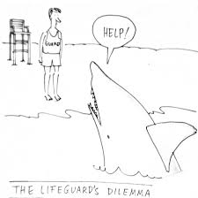
Ethical Dilemma
An ethical dilemma is a conflict between alternatives, where choosing any of them will lead to a compromise of some ethical principle and lead to an ethical violation.
A crucial feature of an ethical dilemma is that the person faced with it should do both the conflicting acts, based on a strong ethical compass, but cannot; he may only choose one.

Slide 15
Examples Of Ethical Dilemma
Dilemma faced by a bank manager regarding the sanction of the loan to a good friend who has been a defaulter earlier.
(dilemma between ‘supporting a good friend’ and ‘high probability of default’).
Dilemma faced by the driver of a corporate executive for using the company vehicle in regularly dropping his physically challenged son of a relative to school.
(dilemma between ‘supporting a needy relative’ and ‘usage of company resource’).

Slide 16
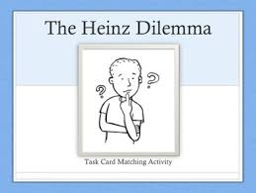
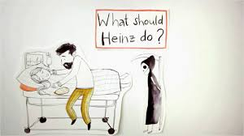
The Story of Heinz
A story of a middle-aged ordinary middle-class man, called Heinz.
His wife suffers from a dreadful disease.
Doctors believe that a special drug which was invented recently and is available at the BIG pharmacy store, can only save his wife.
When Heinz went to buy the drug, the drug-seller cost it around 2,000 dollars, while the actual manufacturing cost of the drug is 2,000 .
Heinz borrowed the money from friends and lenders and could finally collect only $1,000 dollars.
Though Heinz pleaded a lot, the greedy drug-seller refused to sell the drug at a low cost.
Now, Heinz had no other option but to steal the drug from the shop to save the life of his wife.

Slide 17
Features Of Ethical Dilemma
Right choice
Sudden occurrence
Concern
No linkage between two alternatives
Result is unique outcome
Uncertain pressure

Slide 18
Steps to solve Ethical Dilemma

