Slide 1
Theory of interest
Prof. Saptarshi Chakraborty
Taradevi Harakh Chand Kankaria Jain College
Cossipore, Kolkata - 700002

Slide 2
Definition of interest
Interest is the price paid by the borrower to the lender for the use of borrowed funds during a certain period.
In the other words of Eastham: “ Interest is the payment for parting with the advantage of liquid control of money balances”.
According to Batch: “ Interest is the price paid for the use of money or credit”.
It is normally expressed as a percentage on the funds loaned or borrowed.
In the words of J.M.Keynes: “Interest is the premium which has to be offered to induce people to hold their wealth in some form other than hoarded money”.

Slide 3
Gross interest
“The interest earned on a deposit or security before the deduction of tax”.
Element Gross Interest is composed of some or all of the following elements:
Net Interest
Insurance against Risk
Paynent for Inconvenience
Remuneration for Services

Slide 4
Net/pure interest
If from the Gross Interest, we deduct the payments made for :
Insurance against Risks,
Inconvenience, and
For services of the lender,
We are left with Net or Pure Interest. Net or pure Interest is, thus, the payment for loanable funds only.

Slide 5
Definition of Interest Rate
The price which a borrower pays for the use of money he/she does not own, and has no return to the lender who receives for deferring his/her consumption, by lending to the borrower.

Slide 6
Theories of interest
Productivity Theory of Interest
Abstinence or Waiting Theory of Interest
Austrian or Agio Theory of Interest
Loanable Fund Thoery of Interest
Liquidity Preference Theory of Interest
Modern Theory of Interest
From the above mentioned theories, only Loanable Fund Theory of Interest is in your B.Com Sem-4 syllabus.

Slide 7
Loanable Funds Theory
Theory of how the general level of interest rates are determined
Explains how economic and other factors influence interest rate changes
Interest rates determined by demand and supply for loanable funds.
This Thoery proposes that the general level of interest rates is determined by the complex interaction of two forces
Thee first is the total demand for funds by firms, government, and households (or individuals), which carry out a variety of economic activities with those funds. This demand is negatively related to the interest rate (except for the Government’s demand, which may frequently not depend on the level of the interest rate).

Slide 8
Loanable funds theory (contd...)
The Second force affecting the level of the interest rate is the total supply of funds by firms, governments, banks and individuals. Supply is positively related to the level of interest rates, if all other economic factors remain the same. With rising rates, firms and individuals save and lend more, and banks are more eager to extend more loans. (A rising interest rate probably does not significantly affect the government’s supply of savings).

Slide 9
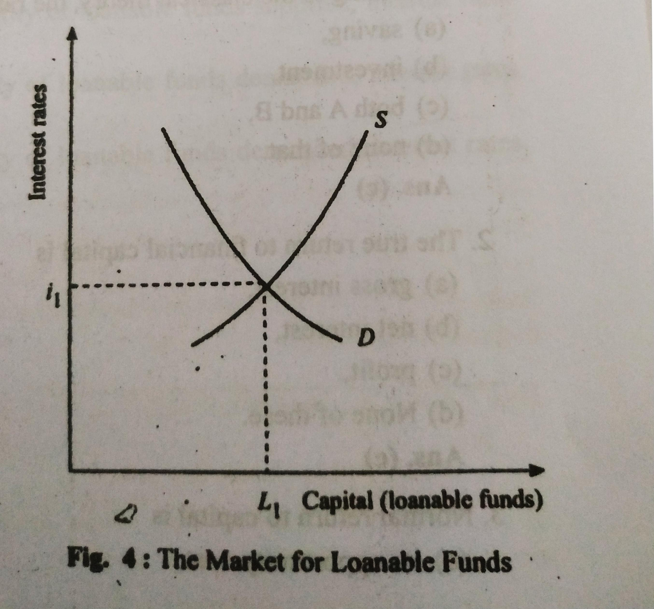
Diagram:

Slide 10
Thank You

