Slide 1
SUBJECT: E-COMMERCE &
BUSINESS COMMUNICATION
PROF. ANJALI GUPTA
DEPT. OF COMMERCE
THK JAIN COLLEGE
SEMESTER: II

Slide 2
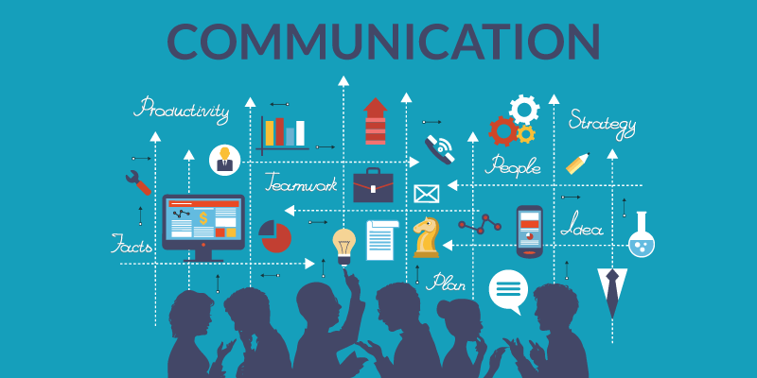

Slide 3
CONTENTS
What is Communication?
Process of Communication
Types of Communication
Levels of Communication
Communication Barriers
Tools of Effective Communication

Slide 14
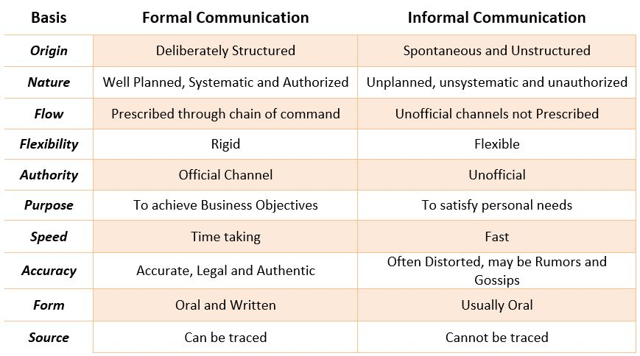
Difference between Formal and Informal Communication

