Slide 1
Semester-II
Company Law Incorporation of Company
Dipak Jaiswal
Department of Commerce (Day)
T.H.K. Jain College

Slide 4
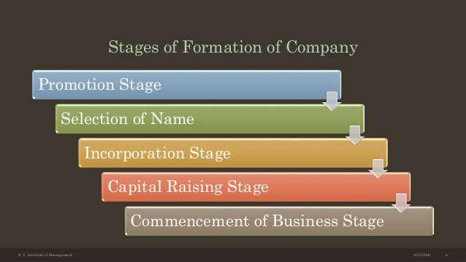

Slide 8
