Slide 1
Stimulation , Support & sustainability in Entrepreneurship
Presented by Prof. PJ
For B. Com(H) – Semester 4th
Subject – ED (Unit – 2)
Section -4 A

Slide 2
InIiiiiIiiiiii
In today’s competitive globalized business paradigm, entrepreneurship happens to be a vital element for sustainable development of any economy.
In order to build a favourable entrepreneurial ecosystem, entrepreneurs should be provided with a platform where they can :-
Come up with Innovative ideas ( i.e. get stimulated)
Get adequate assistance ( i.e. get support)
Ensure their survival in the long run (i.e. be sustainable)

Slide 3
Entrepreneurship Life Cycle
STIMULATION
(To Initiate)
SUPPORT
(To Drive)
SUSTAINABILITY
( To Continue)

Slide 4
STIMULATION
PUBLIC SYSTEM OF STIMULATION
( Initiatives taken by Government)
PRIVATE SYSTEM OF STIMULATION
(Initiative taken by established businesspersons, corporate houses etc.)
APPROACHES
1. Providing Tax Holidays
2.Reduction of Rate of Interest
3.Abolition of Monopoly Privilages
4.Providing Funding
APPROACHES
1.Crowd Funding
2. Angel Investing
3. Encouraging Intrapreneurship

Slide 5
SUPPROT
( Providing Assistances))
FINANCIAL SUPPORT
1.Commercial Bank
2. Non Banking Financial Institutions
3. Angel Investors
4. Shareholders
5. Venture Capitalist
6. Government & Government Institutions
TECHNICAL SUPPORT
1. Participating in International Technology Exhibitions
2. Preparing Technical feasibility profiles
MARKETING SUPPORT
1. Enhancing Marketing Skills
2. Improving Marketing Capabilities
3. Updating Entrepreneurs about current scenario
4.Encourgaing MSME

Slide 6
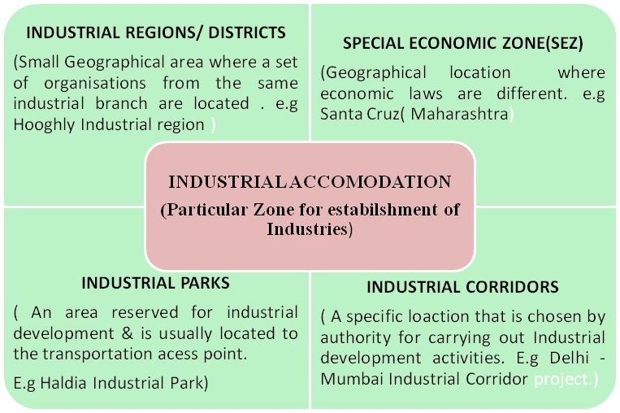

Slide 7
Actors of Entrepreneurship
Industry Association.
Self – Help Group
Business Incubators
Angel Investors
Venture Capitalist

Slide 8
An association that is formed to support & protect the rights of a particular Industry & the persons who are associated with that Industry. E.g. Bus owners association. Features:-- 1. Non – Profit Organization. 2. Voluntary Association. 3. Status of association 4.Distinct laws & Bye – Laws 5. Income & Expenses 6. Periodic Meetings
INDUSTRY ASSOCIATION

Slide 9
It is a voluntary association of people, preferably from the same socio – economic background. They come together for solving their common problems through self – help & mutual help. FEATURES:- 1. Voluntary Association 2.Mutual Trust & need 3. Periodic Meetings 4. No. of Members (Maximum 20 members in a group) 5. No Collateral/ Mortgage for loan 6. Rate of Interest is high.
SELP – HELP GROUPS

Slide 10
It is an organization, which is designed to stimulate, support & enhance the growth & success of Entrepreneurial ventures by providing resources & services. FEATURES:- 1. Non- Profit Organizations. 2.Formations ( By Govt. or successful Entrepreneurs) 3. Physical or Virtual support 4. Bundle of support.
BUSINESS INCUBATORS

Slide 11
Angel Investors are usually high net worth individuals who invest their personal wealth in small or medium scale business start- ups in exchange for an ownership stake in the organization. FEATURES:--- 1. High net – worth persons 2. Investment in small start – up firms 3. Own decision making. 4. Individual Investor. 5. Flexible amount of Investment.
ANGEL INVESTORS

Slide 12
The person providing the venture capital is referred to as the Venture Capitalist. Venture Capital is a type of equity financing which is typically provide to start – up firms & small business that are believed to have long term growth potential. FEATURES:- 1. Long term Investment. 2. Early stage finance 3. High rate of return 4. Risky Capital.
VENTURE CAPITALIST

Slide 13
ANGEL INVESTMENT | VENTURE CAPITAL
In Angel investment, individual investor invest in pre-revenue business | Investment is usually made in pre-profitability business by company which pools money from individuals and institutions
This investment is highly risky since revenue stream is not certain. | This investment is comparatively less risky since revenue stream is proven but the profitability of the invested company is not yet prominent.
Investment size is limited to few million | Owing to pooling of funds, investment size can range from few million to tens of million since the amount of funds at disposal with a venture capitalist is much higher
This investment takes shorter time for decision making since it involves an individual investor | Venture Capitalists take longer time to make the investment decision since they have to address several stakeholders with differing interests. Hence, it is tougher to convince venture

